Slide 1
Core Java 8
Lesson 16 : Multithreading

Slide 2
Lesson Objectives
After completing this lesson, participants will be able to
Understanding threads
Thread life cycle
Scheduling threads- Priorities
Controlling threads using sleep(),join()
Synchronization concept
Inter Thread Communications
Implementations of wait(),notify(),notifyAll() in Producer Consumer problem
Notes:
This lesson covers the usage of Thread in application. It explains how to create Thread program and implement multi threading.
Lesson outline:
16.1: Understanding Threads.
16.2: Thread Life cycle
16.3: Scheduling Thread Priorities
16.4: Controlling thread using sleep() and join()

Slide 3
16.1: Understanding Threads? Thread and Process
Thread
A thread is a single sequential flow of control within a process and it
lives within the process
A light weight process which runs under resources of main process
Inter process Communication is always slower than intra process communication
Actual thread execution highly depends on OS and hardware support.
The JVM of Thread-non-supportive OS takes care of thread execution.
On single processor, threads may be executed in time sharing manner
Notes:
Process Vs Thread :
Understanding Process : A process is nothing but an executing instance of a program which run in separate memory spaces .Processes don’t share the same address space and always stored in the main memory . Once the machine is rebooted it disappears .The execution shifts between the tasks of different processes is known as heavyweight process .Therefore , Inter process communication is always slower
Exp :- Running MicrosoftWord , Notepad , Different instance of Calculator , all works on multiple process .
Understanding Thread : A thread is a single sequential flow of control within a process and it lives within the process . A Java process can be divided into a number of threads (or to say, modules) and each thread is given the responsibility of executing a block of statements . It is termed as a lightweight process, since it is similar to a real process but executes within the context of a process and shares the same resources allotted to the process by the kernel. Inter process Communication is always slower than intra process communication. Process are not easily created where threads are easily created .
Basically a process has only one thread of control – one set of machine instructions executing at one time. In some cases , a process may also be made up of multiple threads of execution that execute instructions concurrently.
In a uni-processor system, a thread scheduling algorithm is applied and the processor is scheduled to run each thread one at a time.

Slide 4
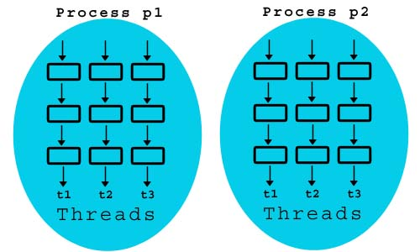
16.1: Understanding Threads? Thread Application
Applications of Multithreading
Playing media player while doing some activity on the system like typing a document.
Transferring data to the printer while typing some file.
Running animation while system is busy on some other work
Honoring requests from multiple clients by an application/web server.

Slide 5
16.1: Understanding Threads? Create Thread using Extending Thread
Extending Thread class to create threads :
Inherited class should:
Override the run() method.
Invoke the start() method to start the thread.
public class HelloThread extends Thread {
public void run(){
System.out.println("Hello .. Welcome to Capgemini.");
}
public static void main(String… args) {
new HelloThread().start();
}
}
Notes:
To create threads, your class must extend the Thread class and must override the run() method. Call start() method to begin execution of the thread. run() method defines the code that constitutes a new thread. run() can call other methods, use other classes, and declare variables just like the main thread. The only difference is that run() establishes the entry point for another, concurrent thread of execution within your program. This ends when run() returns.
}

Slide 6
16.1: Understanding Threads? Creating Thread Implementing Runnable
Another way to Create Thread.
Create a class that implements the runnable interface.
Class to implement only the run method that constitutes the new thread.
public class HelloRunnable implements Runnable {
@Override
public void run() {
System.out.println("Hello .. Welcome to Capgemini ..");
}
}}
public static void main(String… args){
HelloRunnable hello = new HelloRunnable();
Thread helloThread = new Thread(hello);
helloThread . start();
}
Notes:
The Runnable interface should be implemented by any class whose instances are intended to be executed by a thread. The class must define a method of no arguments called run.
Find below the main class to use HelloRunnable Thread
public class HelloMain {
public static void main(String[] args) {
HelloRunnable hello = new HelloRunnable();
Thread helloThread = new Thread(hello);
helloThread.start();
}
}

Slide 7
16.1: Understanding Threads? Thread Extending Vs. Implementing
Extending Thread | Implementing Runnable
Basically for creating worker thread. | Basically for defining task.
It itself is a Thread. Simple syntax | Thread object wraps Runnable object
Can not extend any other class | Can extend any other class
A functionality is executed only once on a thread instance. | A functionality can be executed more than once by multiple worker threads.
Concurrent framework does have limited support. | Concurrent framework provide extensive support.
Thread’s life cycle methods like interrupt() can be overridden. | Only run() method can be overridden.

Slide 8
16.1: Understanding Threads? Thread
Thread API :
Thread Class
run()
start() --- It causes this thread to begin execution; the JVM calls the run method of this thread.
sleep()
join()
stop() ( It is a Deprecated method . ).
getName() - It returns the Thread name in string format.
isAlive() -- It returns thread is alive or not .
currentThread() - It returns the current Thread object.
Runnable Interface
run() - This is the only one method available in this interface .
Common Exceptions in Threads:
InterruptedException .
IllegalStateException
Notes:
Threads can be created either of these two ways
Creating a worker object of the java.lang.Thread class
Creating the task object which is implementing the java.lang.Runnable interface
Using Executor framework which decouples Task submission from policy of worker threads
InterruptedException : It is thrown when the waiting or sleeping state is disrupted by another thread.
IllegalStateException : It is thrown when a thread is tried to start that is already started.

Slide 9
16.1: Understanding Threads? Demo
HelloThread.java
HelloRunnable.java

Slide 10

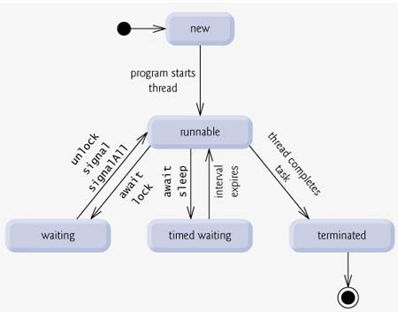
16.2: Thread Life cycle Thread Life Cycle
Notes:
Above-mentioned stages are explained here:
New: A new thread begins its life cycle in the new state. It remains in this state until the program starts the thread. It is also referred to as a born thread.
Thread thread = new Thread(); // New Stage
Runnable: After a newly born thread is started, the thread becomes runnable. A thread in this state is considered to be executing its task.
thread.start() ; // thread is runnable stage where run() is invoked .
Waiting: Sometimes, a thread transitions to the waiting state while the thread waits for another thread to perform a task. A thread transitions back to the runnable state only when another thread signals the waiting thread to continue executing.
wait() is used to send thread to waiting stage and notify() invoked by another thread to bring the waiting thread to runnable stage once again .Those Methods belong to Object class basically used with synchronization method in Multi threading program .
Timed waiting: A runnable thread can enter the timed waiting state for a specified interval of time. A thread in this state transitions back to the runnable state when that time interval expires or when the event it is waiting for occurs.
sleep()
Terminated: A runnable thread enters the terminated state when it completes its task or otherwise terminates.

Slide 11
16.3: Scheduling threads- Priorities Thread Priorities
Thread runs in a priority level . Each thread has a priority which is a number starts from 1 to 10 .
Thread Scheduler schedules the threads according to their priority .
There are three constant defined in Thread class
MIN_PRIORITY
NORM_PRIORITY
MAX_PRIORITY
Method which is used to set the priority
setPriority(PRIORITY_LEVEL);
Do not rely on thread priorities when you design your multithreaded application .
Notes:
One can modify the thread priority using the setPriority(PRIORITY_LEVEL) method.
Thread Priority level and their constant Values:
MIN_PRIORITY - 1
NORM_PRIORITY - 5
MAX_PRIORITY - 10
Default priority of a thread is always 5 .
Note: Do not rely on thread priorities when designing your multithreaded application. Because thread-scheduling priority behavior is not guaranteed, use thread priorities as a way to improve the efficiency of your program, but just be sure your program doesn't depend on that behavior for correctness.
The thread scheduler is the part of the JVM (although most JVMs map Java threads directly to native threads on the underlying OS) that decides which thread should run at any given moment, and also takes threads out of the run state. Assuming a single processor machine, only one thread can actually run at a time. Only one stack can ever be executing at one time. And it's the thread scheduler that decides which of the thread is eligible for the next execution.
Any thread in the runnable state can be chosen by the scheduler to be the one and only running thread. If a thread is not in a runnable state, then it cannot be chosen to be the currently running thread.
The order in which runnable threads are chosen to run is not guaranteed. Although queue behavior is typical, it isn't guaranteed. Queue behavior means that when a thread has finished with its "turn," it moves to the end of the line of the runnable pool and waits until it eventually gets to the front of the line, where it can be chosen again. In fact, you call it a runnable pool, rather than a runnable queue, to
help reinforce the fact that threads aren't all lined up in some guaranteed order. Although you do not control the thread scheduler .

Slide 12
16.3: Scheduling threads- Priorities Demo
ThreadPriorityDemo

Slide 13
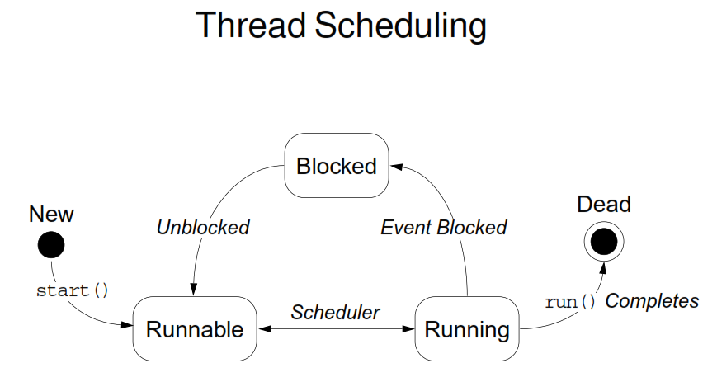
16.4: Controlling threads using sleep(),join() Threads in Blocked Stage
Number of ways a thread can be brought to blocked state.
By calling sleep() method
By calling suspend() method
By calling wait() method
Notes:
Number of ways a thread can be brought to blocked state
A normal running thread can be brought, a number of ways, into blocked state, listed hereunder.
By calling sleep ( ) method.
By calling suspend ( ) method.
When wait() method is called as in synchronization
When an I/O operation is performed, the thread is implicitly blocked by JVM.

Slide 14
16.4: Controlling threads using sleep(),join() Controlling thread using sleep()
The Thread class provides two methods for sleeping a thread:
public static void sleep(long milliseconds)throws InterruptedException
public static void sleep(long milliseconds, int nanos)throws InterruptedException
Notes:
public static void sleep(long milliseconds)throws InterruptedException :
The sleep(long millis) method of Thread class causes the currently executing thread to sleep for the specified number of milliseconds, subject to the precision and accuracy of system timers and schedulers. if any thread has interrupted the current thread. The current thread interrupted status is cleared when this exception is thrown.
public static void sleep(long milliseconds, int nanos)throws InterruptedException :
The above method implementation causes the currently executing thread to sleep (temporarily pause execution) for the specified number of milliseconds plus the specified number of nanoseconds, subject to the precision and accuracy of system timers and schedulers
Example given below :---
package com.capgemini.lesson16;
import java.util.ArrayList;
import java.util.Arrays;
import java.util.List;
public class SleepDemo {
public static void main(String args[]) {
List<String> seasonList = new ArrayList<>();
seasonList = Arrays.asList(new String[]{
"Winter",
"Summer",
"Spring",
"Autumn"
});
for (String value : seasonList) {
//Pause for 4 seconds
try {
Thread.sleep(4000);
} catch (InterruptedException exp) {
System.err.println(exp.getMessage());
}
//Print a message
System.out.println(value);
}
}
}

Slide 15
16.2: Thread Life cycle Demo
ThreadLifeCycleDemo.java
Notes:
public class ThreadLifeCycleDemo extends Thread {
public void run(){
System.out.println("In side run() Thread is alive or not "+this.isAlive());
int num = 0;
while (num < 4) {
num++;
System.out.println("num = " + num);
try {
sleep(500);
System.out.println("In not runnable stage, Thread is alive or not "+this.isAlive());
} catch (InterruptedException exp) {
System.err.println("Thread Interrupted ...");
}
}
}
public static void main(String[] args) {
Thread myThread = new ThreadLifeCycleDemo();
System.out.println("Before Runnable stage Thread is alive or not : "+myThread.isAlive());
myThread.start();
try{
myThread.sleep(4000);
}
catch(InterruptedException exp){
System.err.println("Thread is interrupted !");
}
//myThread.stop();
System.out.println("After complete execution of Thread ,it is alive or not "+myThread.isAlive());
}
}

Slide 16
16.4: Controlling threads using sleep(),join() Controlling Thread using join()
In Tread join method can be used to pause the current thread execution
until unless the specified thread is dead.
There are three overloaded join functions.
public final void join()
public final synchronized void join(long millis)
public final synchronized void join(long millis, int nanos)
Notes:
public final void join() : This method puts the current thread on wait until the thread on which it’s called is dead. If the thread is interrupted, it throws InterruptedException.
public final synchronized void join(long millis) : This method is used to wait for the thread on which it’s called to be dead or wait for a specified milliseconds. Since thread execution depends on OS implementation, one can’t guarantee that the current thread will wait only for given time .
public final synchronized void join(long millis, int nanos): This method is used to wait for thread to die for given milliseconds plus nanoseconds.

Slide 17
16.4: Controlling threads using sleep(),join() Demo :
ThreadJoinDemo . Java
SleepDemo.java
Notes:
public class ThreadJoinDemo {
public static void main(String[] args) {
// TODO Auto-generated method stub
Thread thread1 = new Thread(new MyRunnable(), "First");
Thread thread2 = new Thread(new MyRunnable(), "Second");
Thread thread3 = new Thread(new MyRunnable(), "Third");
thread1.start();
//start second thread after waiting for 10 seconds or if it's dead
try {
thread1.join(10000);
} catch (InterruptedException exp) {
System.err.println(exp.getMessage());
}
thread2.start();
//start third thread only when first thread is dead
try {
thread1.join();
} catch (InterruptedException exp) {
System.err.println(exp.getMessage());
}
thread3.start();
//let all threads finish execution before finishing main thread
try {
thread1.join();
thread2.join();
thread3.join();
} catch (InterruptedException exp) {
System.err.println(exp.getMessage());
}
System.out.println("All threads are dead, exiting main thread");
}
}

Slide 18
16.5: Synchronization concept Problems with Shared Data
Shared data must be accessed cautiously.
Instance and static fields:
Are created in an area of memory known as heap space
Can potentially be shared by any thread
Might be changed concurrently by multiple threads
There are no compiler or IDE warnings.
“Safely” accessing shared fields is developer’s responsibility.
Notes:
Nonshared Data
Some variable types are never shared. The following types are always thread-safe:
Local variables
Method parameters
Shared Thread-Safe Data
Any shared data that is immutable, such as String objects or final fields, are thread-safe because they can only be read and not written.

Slide 19
16.5: Synchronization concept Multithreading without Synchronization
Demo

Slide 20
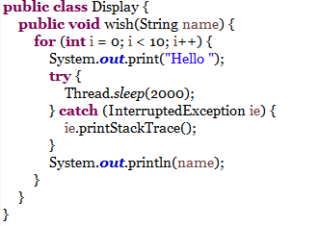
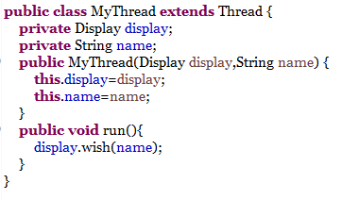
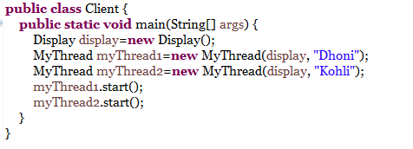
Without Synchronization Demo

Slide 21
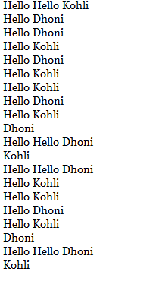
Without Synchronization Demo output

Slide 22
16.5: Synchronization concept Synchronization
If multiple threads trying to operate simultaneously on given java object then there may be a chance of data inconsistency problem.
To over come this problem one should go for SYNCHRONIZED keyword. The main advantage of synchronized keyword is we can overcome data inconsistency problem
In synchronized method the whole object is get locked with thread .
in synchronized block , the locked occurred for a particular resource
Synchronization makes a program to work very slow as only one thread can access the data at a time
Notes:
If multiple threads trying to operate simultaneously on given java object then there may be a chance of data inconsistency problem. To over come this problem one should go for SYNCHRONIZED keyword.
If a method or block declared as synchronized only one thread is allowed to operate on the given object.
Synchronization can be implemented by
Synchronized method
Synchronized block
In synchronized method the whole object is get locked with thread where in synchronized block , the locked occurred for a particular resource .
The main advantage of synchronized keyword is we can overcome data inconsistency problem.
Synchronization makes a program to work very slow as only one thread can access the data at a time. Designers advice to synchronize only the important and critical statements of the code. Do not synchronize unnecessarily.
But the main disadvantage of synchronized keyword is it increases waiting time of threads and creates performance problem. Hence unless it is a specific requirement we do not use synchronization.

Slide 23

16.5: Synchronization concept Object Monitor Locking
Every object in Java has a lock
Using synchronization enables the lock and allows only one thread to access that part of code.
Each object in Java is associated with a monitor,
which a thread can lock or unlock.
Notes:
This is one of the (happen before )mechanism which is implemented in multithreading environment, for top control the access of multiple threads to any shared resource. If we want only one thread should access the resource at a time in parallel environment we use synchronization .
It is used to prevent thread interference and to avoid consistency problem .

Slide 24
16.5: Synchronization concept Object Monitor Locking
Each object in Java is associated with a monitor, which a thread can lock or unlock.
synchronized methods use the monitor for the this object.
static synchronized methods use the classes’ monitor.
synchronized blocks must specify which object’s monitor to lock or unlock and it can be nested .
synchronized ( this ) {
}
Notes:
This is one of the (happen before )mechanism which is implemented in multithreading environment, for top control the access of multiple threads to any shared resource. If we want only one thread should access the resource at a time in parallel environment we use synchronization .
It is used to prevent thread interference and to avoid consistency problem .
Nested synchronized Blocks
A thread can lock multiple monitors simultaneously by using nested synchronized blocks.

Slide 25
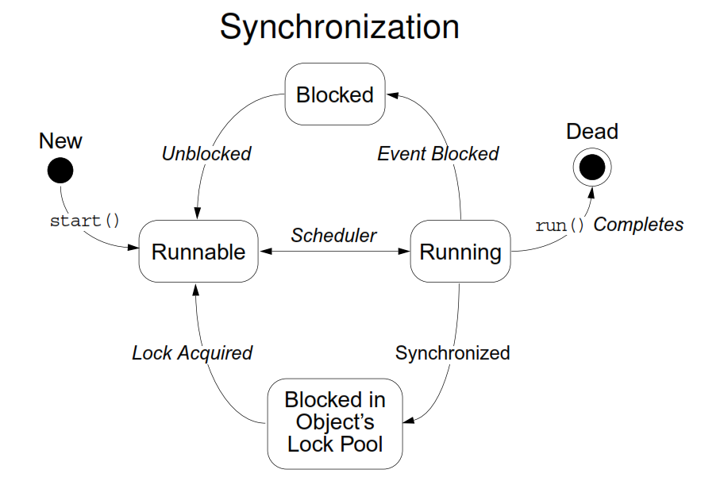
16.5: Synchronization concept Synchronization

Slide 26
16.5: Synchronization concept Synchronization
The synchronized keyword in the method declaration. This tells Java that the method is synchronized.
A synchronized instance method in Java is synchronized on the instance (object) owning the method.
public synchronized void add(int value){
this.count += value;
}
Notes:
Synchronized methods are an elegant variation on a time-tested model of interprocess-synchronization: the monitor
The monitor is a thread control mechanism
When a thread enters a monitor (synchronized method), all other threads, that are waiting for the monitor of same object, must wait until that thread exits the monitor
The monitor acts as a concurrency control mechanism

Slide 27
16.5: Synchronization concept Synchronized Method
Implementation of concurrency control mechanism is very simple because every Java object has its own implicit monitor associated with it.
If a thread wants to enter an object’s monitor, it has to just call the synchronized method of that object
While a thread is executing a synchronized method, all other threads that are trying to invoke that particular synchronized method or any other synchronized method of the same object, will have to wait
Notes:
If a thread wants to execute any synchronized method on a given object, once it has to get the lock. Then it is allowed to execute any synchronized method on that object.
Once synchronized method execution completed then lock is released automatically by thread.

Slide 28
16.5:synchronization concept Multithreading without Synchronization
Demo

Slide 29
16.5: Synchronization concept With Synchronization – Static Method Level
The synchronized keyword in the method declaration. This tells Java that the method is synchronized.
Synchronized static methods are synchronized on the class object of the class where the synchronized static method present.
public static synchronized void add(int value){
count += value;
}
Notes:
Synchronized static methods are synchronized on the class object of the class the synchronized static method belongs to. Since only one class object exists in the Java VM per class, only one thread can execute inside a static synchronized method in the same class.
If the static synchronized methods are located in different classes, then one thread can execute inside the static synchronized methods of each class. One thread per class regardless of which static synchronized method it calls.

Slide 30
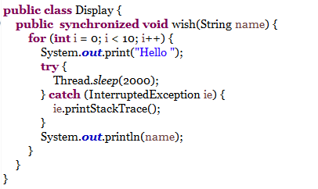
With Synchronization – Method Level Demo

Slide 31
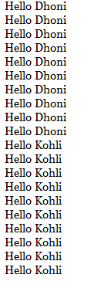
With Synchronization – Method Level Demo output

Slide 32
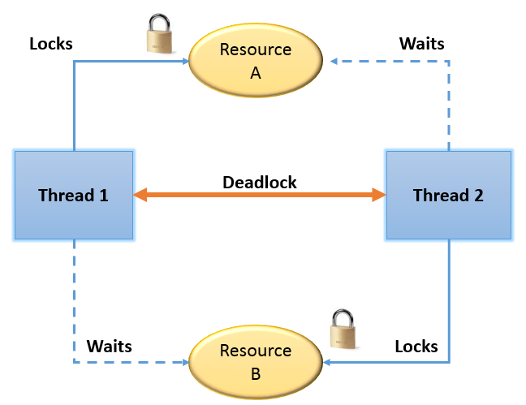
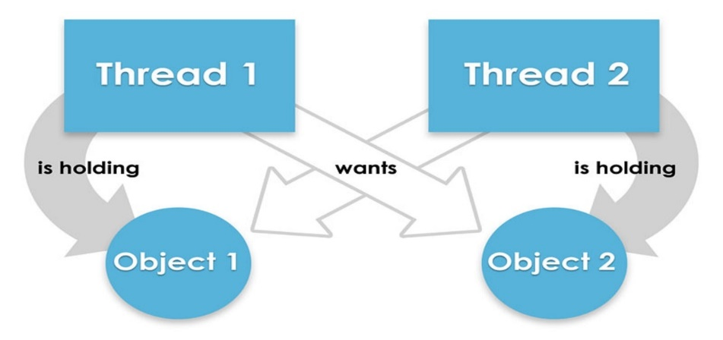
16.6: Inter thread communication Deadlock
Deadlock results when two or more threads are blocked forever, waiting for each other.
A deadlock has the below characteristics
It is two threads , each waiting for a lock from the other.
It is not detected or avoided
Notes:
Starvation and livelock are much less common a problem than deadlock, but are still problems that every designer of concurrent software is likely to encounter.
Starvation
Starvation describes a situation where a thread is unable to gain regular access to shared resources and is unable to make progress. This happens when shared resources are made unavailable for long periods by “greedy” threads. For example, suppose an object provides a synchronized method that often takes a long time to return. If one thread invokes this method frequently, other threads that also need frequent synchronized access to the same object will often be blocked.
Livelock
A thread often acts in response to the action of another thread. If the other thread’s action is also a response to the action of another thread, livelock may result. As with deadlock, livelocked threads are unable to make further progress. However, the threads are not blocked; they are simply too busy responding to each other to resume work.

Slide 33
16.6: Inter thread communication Inter-Thread Communication
When more than one thread uses a shared resource they need to synchronize with each other.
While using a shared resource the threads need to communicate with
each other, to get the expected behaviour of the application.
Java provides some methods for the threads to communicate

Slide 34
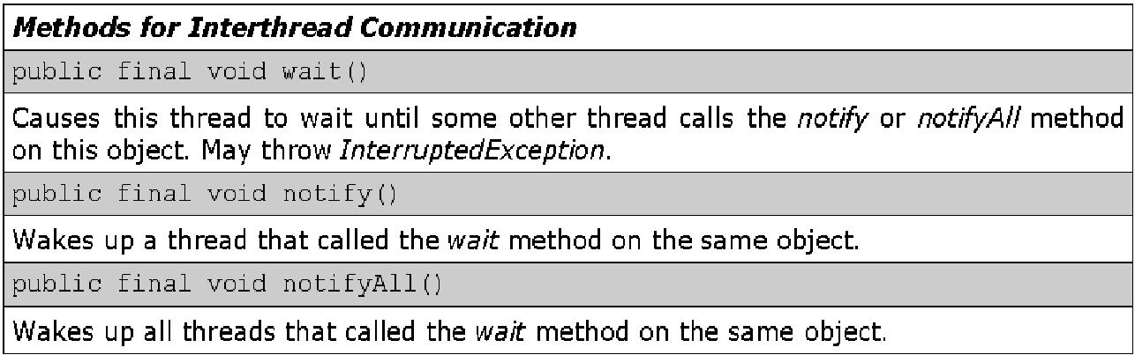
16.7: Implementations of wait(),notify(),notifyAll() Inter-Thread Communication

Slide 35
16.7: Implementations of wait(),notify(),notifyAll() Inter-Thread Communication
Threads are often interdependent - one thread depends on another thread to complete an operation, or to service a request.
The words wait and notify encapsulate the two central concepts to thread communication
A thread waits for some condition or event to occur.
You notify a waiting thread that a condition or event has occurred.
To avoid polling, Java’s elegant inter-thread communication mechanism uses:
wait( )
notify( ), and notifyAll( )

Slide 36
16.7: Implementations of wait(),notify(),notifyAll() Inter-Thread Communication (Contd.).
wait( ), notify( ) and notifyAll( ) are:
Declared as final in Object
Hence, these methods are available to all classes
These methods can only be called from a synchronized context
wait( ) directs the calling thread to surrender the monitor, and go to sleep until some other thread enters the monitor of the same object, and calls notify( )
notify( ) wakes up the other thread which was waiting on the same object(that had called wait() previously on the same object)

Slide 37
16.7: Implementations of wait(),notify(),notifyAll() Producer-Consumer Problem
Producing thread may write to buffer (shared memory)
Consuming thread reads from buffer
If not synchronized, data can become corrupted
• Producer may write before consumer read last data
• Data lost
• Consumer may read before producer writes new data
• Data "doubled"

Slide 38
16.7: Implementations of wait(),notify(),notifyAll() Producer-Consumer Problem (Contd.).
Using synchronization
If producer knows that consumer has not read last data, calls wait (awaits a notify command from consumer)
If consumer knows producer has not updated data, calls wait (awaits notify command from producer)

Slide 39
16.7: Implementations of wait(),notify(),notifyAll() Producer-Consumer Problem (Contd.).
Incorrect Implementation
synchronized int get() {
System.out.println("Got: " + n);
return n;
}
synchronized void put(int n) {
this.n = n;
System.out.println("Put: " + n);
}

Slide 40

16.7: Implementations of wait(),notify(),notifyAll() Producer-Consumer Problem (Contd.).

Slide 41
16.7: Implementations of wait(),notify(),notifyAll() Producer-Consumer Problem (Contd.).
Correct Implementation
synchronized int get() {
if(!valueSet)
try {
wait();
} catch(InterruptedException e)
{ System.out.println("InterruptedExce
ption caught");
}
System.out.println("Got: " + n);
valueSet = false;
notify();
return n;
}

Slide 42

16.7: Implementations of wait(),notify(),notifyAll() Producer-Consumer Problem (Contd.).

Slide 43
16.7: Implementations of wait(),notify(),notifyAll() Inter-Thread Communication (Contd.).
The following sample program implements a simple form of the Producer/Consumer problem
It consists of four classes namely:
Factory , that you are trying to synchronize
Producer, the threaded object that is producing data
Consumer, the threaded object that is consuming
data
Main, the class that creates the single Factory,
Producer, and Consumer

Slide 44
16.1: Understanding Threads? Demo
Factory.java
Producer.java
Consumer.java
Main.java

Slide 45
Lab
Lab 8: Multithreading

Slide 46
Summary
In this lesson, you have learnt the following:
What is Thread and use of Multithread
how to create a Thread program and Lifecycle?
Thread Priorities Implementation in Multi Threading
environment .
Use of sleep() , join()
Synchronization concept
Different types of Synchronization
Inter thread communication
Producer – consumer problem by using wait(),notify(), notifyAll()
Notes:
Add the notes here.

Slide 47
Review Question
Question 1 which method is invoked to send thread
object to runnable stage.
Option 1 : start()
Option 2 : stop()
Question 2: Does sleep() belongs to Thread class ?
True/False.

Slide 48
Review Question
Question 3 which of the following is not a type of synchronization.
Option 1 : by block
Option 2 : by method()
Option 3 : by variable
Question 4: Which of the following Some variable types are never shared.
Option 1: Local variables.
Option 2 : Instance variables
Option 3 : Method parameters

